Slide 1
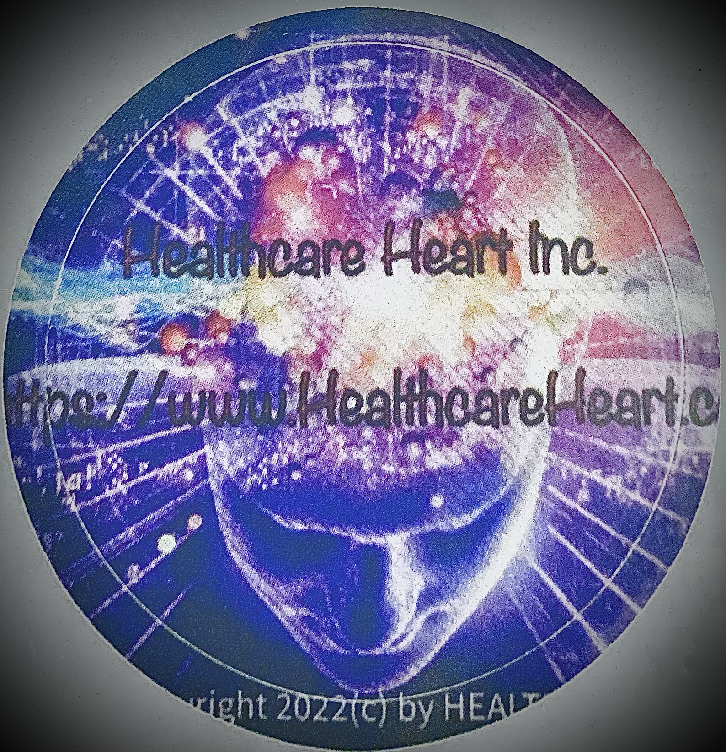

Presentation Created by: Jenna Chou, PMP
Healthcare Heart Inc.
Executive Summary

Slide 2
Written by: Roderick Warnes 2023©️
We have all most probably heard that mental health issues have, since the outbreak of the Covid 19 Pandemic become a major topic of concern within the Healthcare Industry. Why is this suddenly happening? Is it really only just being recognised or is it something we’ve missed or maybe have chosen not to recognised within society?
If for instance a person has an accident and say breaks an arm or a leg, they carry the evidence for all to see. They have to wear a cast or one of those much seen today medical “boots”. Unlike physical injuries, mental health illnesses are generally not so easy to see and not so apparent! This is especially true for “invisible” mental health issues. These stigmas and the lack of public awareness, along with the shortage of mental health healthcare professionals that truly understands their patients due to their busy schedule bandwidth. Put it simply, in the past mental health was kept a secret and not something discussed or indeed held up for discussion or certainly not put out there in plain sight?

Slide 3
Written by: Roderick Warnes 2023©️
Why is this? Well for one thing, nobody really know how to confront their own issues, and it was not something that was easily cured, medically wise that is. If you visited your M.D., in countries with Family Doctor Practices, you would most likely be given some pills to take, and from there, you had to get on with your own life on your own, often with little or no help from the appropriate healthcare professionals. Often, people would just be expected to “shake it off”, and then wake up and “smell the roses”. Or, according to most people you speak to, they just need a “kick up their backside”. If you brought up the subject among family and friends, you are expected to hit a “brick wall”, while the immediate family members wondering what’s wrong with you. It was just something not to discuss or chat about. We can all probably recall being told about “aunty so and so”, who everyone thought was a mental case and very likely hidden away from the world. The only people you heard about that was getting treatment was film stars and alike.
So, what has changed and more importantly why? Well, suddenly, it’s not a taboo subject anymore. More and more institutions, sports bodies, and businesses, are realizing that good mental health is a must, just like just as important as physical health. When once it was kept quiet, now it is OK to talk about them, and when necessary, get the right and appropriate healthcare professionals’ help. If you broach the subject with friends or family, you more than likely will hear all about “so and so” or someone close that they know has been diagnosed with some kind of mental health issues. More and more, it is slowly becoming a subject that can be talked about publicly, thank goodness to the real-world mental health professionals like DR. JORDAN PETERSON.

Slide 4
Written by: Roderick Warnes 2023©️
Mental health affects large numbers of people worldwide. To some, it is still remaining as taboo, but thankfully, it is slowly becoming recognized as something not to be embarrassed about. More and more we are hearing stories, both good and bad and there are many more places we go to for help! However, the shortage of mental health professionals around the world is still a huge issue that we should be aware of and care about how to 8mprove the systems.
Today there are many helplines and volunteer or Non-For-Profit (NFP) organizations springing up. There are 24/7 Emergency Rooms, so to speak, if they are available in the individual’s country. There’s somewhere we can turn to for help and guidance. People are starting to understand that its” OK” not to feel “OK”. There is help out there for everyone, and WE are very importantly “NOT ON OUR OWN” anymore.
We have all read books where prisoners get kept in solitary confinement. We read how they struggled mentally, and often ended up as “basket cases” when they finally get out of the penitentiary, in most cases, commit more crimes afterwards. But that’s another deep topic to get into.
So, how close was that for all of us during the pandemic? How much did we come to understand to value the value of how important mental health is for everyone? To hear, to feel, and to talk about anything that stimulates us. It is not hard to appreciate what many of us went through. But, hey, anyone that has or has had mental health issues will tell you that their lives felt that they were on their own! They felt isolated and it was only once they sought help, they understood that they weren’t alone and there is help out there. Today it might be as easy as getting on Google and typing in “help for mental health”.
So what is HH and why was it founded?

Slide 5
Written by: Jenna Chou, PMP 2023©️
Public Stigma on Mental Health
Mental health includes the emotional, psychological, and the social well-being of every human being. Put the simply, it can impact how we think, act, as well as how we interact with one another. Mental health can and will change at different stages of one’s life, from childhood to adolescence, to adulthood, and ultimately, the HOLISTIC mental health of every individual. It affects how we manage stress, navigate decision-makings, choose healthy options, as well interact and relate with others.
One in three Canadians, which is about 9.1 million people, will be affected by mental health issues during their lifetime (thelucidproject.ca, 2022). The gap between people needing care, and those with actual access to care, is extremely significant. This calls for the need for immediate attention and solutions!!!! What HEALTHCARE HEART INC.®️ aims to achieve is to provide therapies and rehabilitations that can be done both physically in-person, but more urgently, through virtual audio/video consultations and online therapy sessions.

Slide 6
Written by: Jenna Chou, PMP 2023©️
Connecting with other similar patients who has the same mental health issues, or maybe just going through a temporary crisis, is also one of the extremely important components when talking about the healing process, and moving on after the healing process is over. However, in most cases, the healing process never stops, and you just have to keep fighting o and discover what is best in YOU! For example, people with clinical depression, bipolar disorder, anxiety, panic attacks, even PTSD, can, and will experience the ups and downs throughout their lives, at times, struggling to find their safe haven throughout their lives.
That is OK! YOU are OK! There’s nothing wrong with you, it is just a slight setback in your life…. that you would need assistants from healthcare professionals and family/friends to help you through the hurdle. HEALTHCARE HEART INC.®️ will be there to help. To provide the most advanced and comprehensive HOLISTIC APPROACHES to mental health healing by looking at the bigger picture with every angle taken into consideration and analyzed to develop therapeutic strategies (CBT - Cognitive Behavioral Therapy) that best works for YOU, by having the dedicated healthcare professionals who are experienced and passionate to help. REMEMBER, YOU ARE NEVER ALONE!

Slide 7
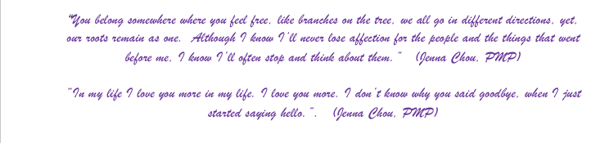
Written by: Jenna Chou, PMP 2023©️
Suicide Prevention
Healthcare Heart Inc.®️ is also founded based on a very personal and regretful life story of the Founder, Jenna Chou, PMP. This is a very brief and painful version of how this story ends, but begins at the same time.
In 2019, I lost my best friend and ‘brother’ to suicide. It was an ‘accident’ that should have never occurred. To lose someone so special in your life is the most painful experience one can handle. Consequently, Healthcare Heart Inc.®️ decided to dedicate health professionals, who takes depression and suicide ‘idealization’ seriously and provides therapy and rehabilitation to get those who seek help out of any suicidal thoughts.
The below close, essentially summarizes what Healthcare Heart Inc®️. aims to assist.

Slide 8
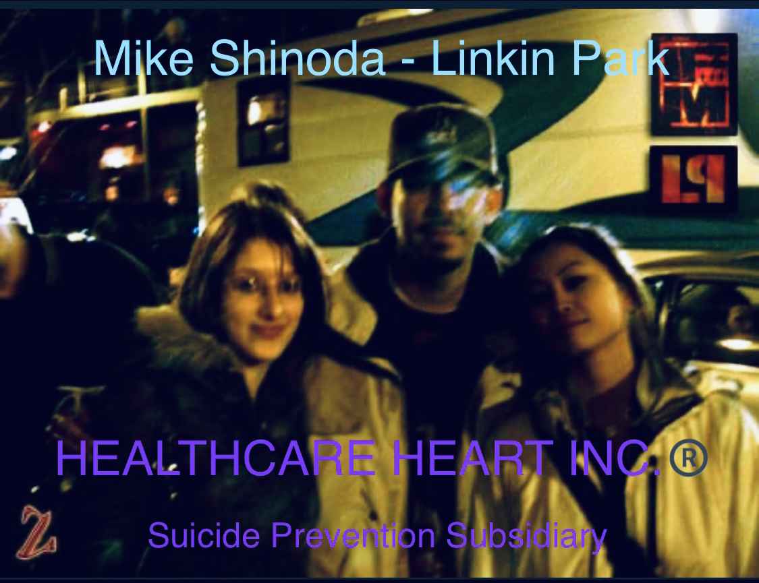
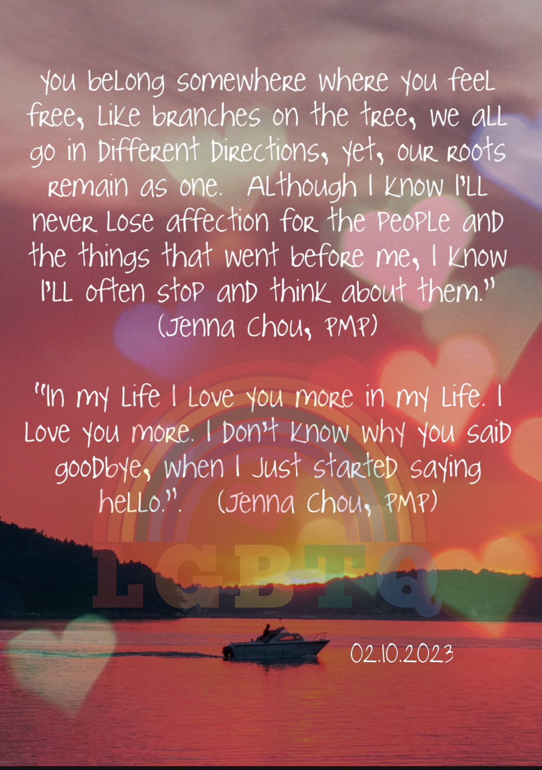
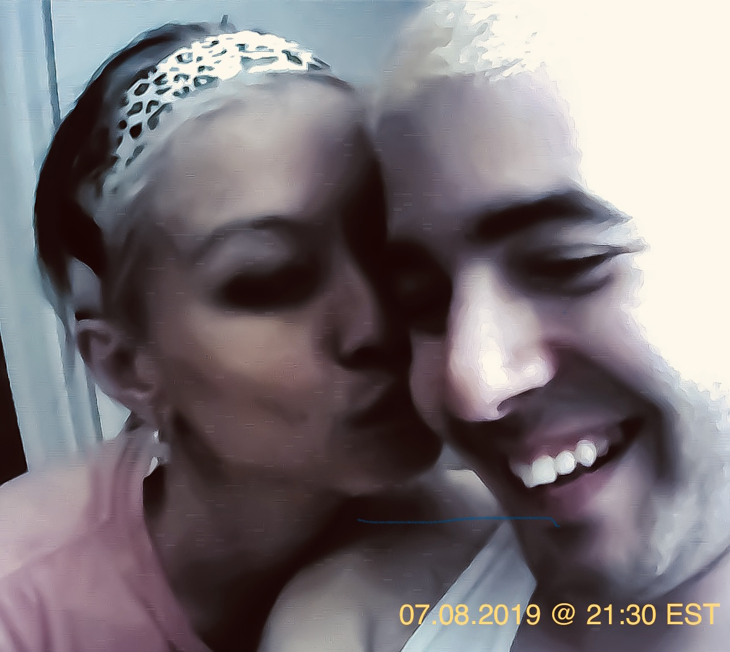
Written by: Jenna Chou, PMP 2023©️

Slide 9
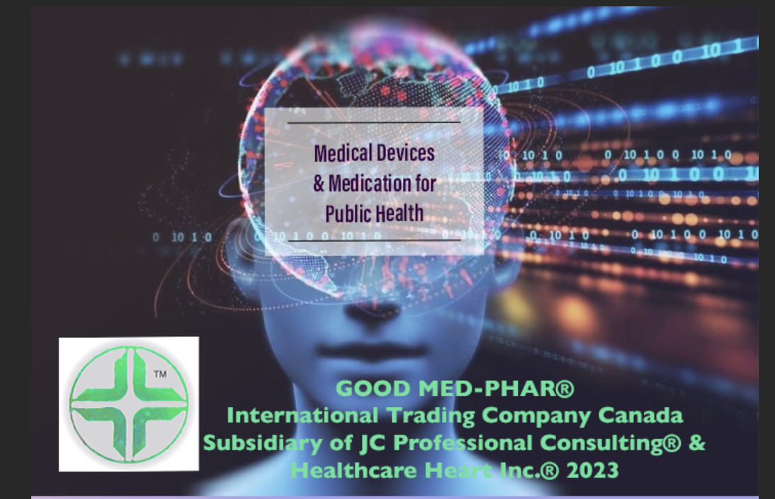

Slide 10
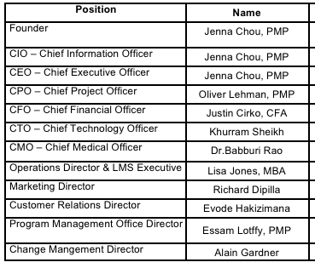
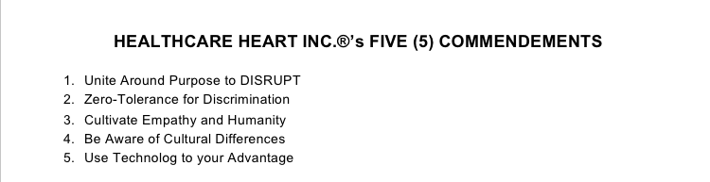
💕Thank You💕

